Slide 1
Automatic Docker Monitoring
Agentless Docker monitoring with HP SiteScope
Michael Mishalov/ 23 June 2015

Slide 2
SiteScope Overview

Slide 3
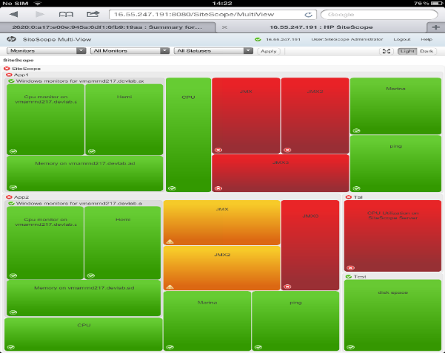
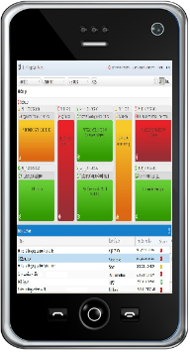
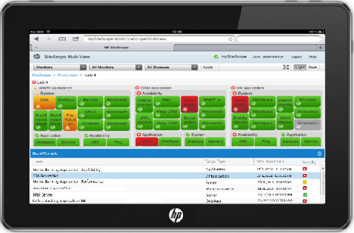
What is SiteScope?
SiteScope software is
agentless monitoring for availability and performance of distributed IT infrastructures and applications
Tablet friendly, Multiview dashboard viewed anytime, anywhere on iPhone/iPad/ Android devices
Hierarchical, can be managed across multiple servers
Virtualization and Cloud ready e.g.AWS and Cloud Watch
Running in 9 mins (freemium)
Easily extended a rich catalog of solutions templates
Application Monitors Active Directory Replication, Apache Server, BroadVision App Server, Check Point, Cisco Works, Citrix, ColdFusion Server, COM+ Server, F5 Big-IP, HAProxy, Mail, MAPI, Memcached, Hadoop
Server Monitors Windows Performance, CPU, Disk Space (Deprecated), DHCP | Media Monitors MS Lync Server, MS Archiving Server, | Virtualization and Cloud Monitors Amazon Web Services, Generic Hypervisor, KVM, Microsoft Hyper-V, Solaris Zones, VMware
Database Monitors Microsoft SQL Server, Oracle DB | Integration Monitors HP OM Event, HP SM, NetScout Event | Generic Monitors Multi Log, Script, Syslog, Web Service, XML Metrics
Network Monitors Network Bandwidth, Ping, Port, … | Web Transaction Monitors URL Content, URL List, URL Sequence, Web Script | Custom Monitors Custom Monitor, Custom Database, Custom Log File, Custom WMI
Table exposes examples of each category
Notes:
Application Monitors
Active Directory Replication, Apache Server, BroadVision App Server, Check Point, Cisco Works, Citrix, ColdFusion Server, COM+ Server, F5 Big-IP, HAProxy, Mail, MAPI, Memcached Statistics, Microsoft (MS) ASP Server, MS Exchange. MS Exchange Mailbox, MS Exchange Message Traffic, MS Exchange Public Folder, MS IIS Server, News, Oracle 9i & 10g Application Server, Radius, SAP CCMS, SAP CCMS Alerts, SAP Java Web Application Server, SAP Performance, SAP Work Processes, Siebel Application
Server Monitors
Browsable Windows Performance, CPU, Disk Space (Deprecated), DHCP, Dynamic Disk Space, HP iLO (Integrated Lights-Out), HP NonStop Event Log, HP NonStop Resources, IPMI, Memory, Microsoft Windows Event Log, MS Performance Counter, MS Resources, MS Services State , Service, UNIX Resources
Server, Siebel Log File, Siebel Web Server, SunONE Web Server,
Database Monitors
Database Counter, Database Query, DB2, LDAP, Microsoft SQL Server, Oracle Database, Sybase Monitor
Network Monitors
DNS, FTP, Microsoft Windows Dial-up, Network Bandwidth, Ping, Port, SNMP, SNMP Trap, SNMP by MIB
Media Monitors
Microsoft A/V Conferencing Server, MS Lync Server, MS Archiving Server, MS Director Server, MS Edge Server, MS Front End Server, MS Mediation Server, MS Monitoring and CDR Server, MS Registrar Server, MS Windows Media Player, Real Media Player
Integration Monitors
HP OM Event, HP Service Manager, NetScout Event, Technology Database Integration, Technology Log File Integration, Technology SNMP Trap Integration, Technology Web Service Integration
Web Transaction Monitors
e-Business Transaction, Link Check, URL, URL Content, URL List, URL Sequence, Web Script
Virtualization and Cloud Monitors
Amazon Web Services, Generic Hypervisor, KVM, Microsoft Hyper-V, Solaris Zones, VMware Datastore, VMware Host CPU, VMware Host, VMware Host Memory, VMware Host Network, VMware Host State, VMware Host Storage, VMware Performance Monitor
Generic Monitors
Composite, Directory, Formula Composite, File, JMX, Log File, Multi Log, Script, Syslog, Web Service, XML Metrics
Custom Monitors
Custom Monitor, Custom Database, Custom Log File, Custom WMI

Slide 4














How HP SiteScope works
Reports
Alerts
Dashboard
Unified Console
Users & Admins
Integrations
Mobile
HP SiteScope
End User
Firewalls
Network Devices
Load Balancers
Physical & Virtual
Servers
Application Servers
Webservers
Big Data Databases
Notes:
HP SiteScope is an agentless monitoring solution designed to ensure the availability and performanceof distributed IT infrastructures—for example, servers, operating systems, network devices, network services, applications, and application components.This Web-based infrastructure monitoring solution is lightweight, highly customizable, and does notrequire that data collection agents be installed on your production systems. With SiteScope, you gainthe real-time information you need to verify infrastructure operations, stay apprised of problems, andsolve bottlenecks before they become critical.
-------------------
HP SiteScope provides a holistic view of the IT environment, including consolidated events and metrics from both physical and virtual resources
And SiteScope do this simply. There is nothing to install at the resource to be monitored. We define everything remotely and access at execution time.
All of this rich data comes back into SiteScope and drives the engine that provides value back to the customer – the dash boarding, reporting, alerting, etc.
So how does SiteScope work? Basically, you install SiteScope on host machines with access to the applications and operating systems that you want to monitor.
SiteScope logs into systems and collects key performance measurements on a wide range of back and front-end infrastructure components, including Big Data, Databases, Applications, Physical and Virtual servers, Networks, Firewalls and End User Experience.
SiteScope provides access to this measurements in a variety of ways including a Dashboard, as well as the new Unified Console (combination of Multi-View and Event Console)
SiteScope includes reporting capabilities (you can custom you own reports and even schedule reports to be sent via email)
SiteScope provides alerting where based on configured thresholds, alerts are sent to notify system/application administrators of failures.
SiteScope provides user management, as well as LDAP users integration
SiteScope provides sending events and data to any external application using generic data integrations, generic event integrations (sending either data or events to any external application) as well integrations with other HP products.
SiteScope provides public APIs based on soup APIs for monitors creation and management without using SiteScope UI.
Finally, SiteScope provides mobile access so IT staff can take SiteScope wherever they go with the ability to take action from their mobile devices.
One of the great benefits of SiteScope is agentless technologies:
The point is that agentless is simple. It helps you reduce the cost of ownership of your monitoring solution and it gives you an option to quickly deliver monitoring over a vast and varied environment.

Slide 5
HP SiteScope Monitors
Improve availability and performance
Server Monitors CPU, Dynamic Disk Space, Memory, Service, iLO, IPMI, Unix Resources, Syslog, Web Server, NonStop Resources/Event Log. MS Windows: Performance Counter, Event Log, Resources, Services State | Network Monitors Formula Composite, SNMP, SNMP by MIB, SNMP Trap, DNS, FTP, Port, Ping, Mail, MAPI, Network Bandwidth, MS Windows Dialup,
Big Data, Database Monitors Vertica, Hadoop, IBM DB2, Oracle Database, Microsoft SQL Server, Sybase Database, Database Counter, Database Query | Web Monitors e-Business Transaction, WebScript, Link Check, URL, URL Content, URL List, URL Sequence
Streaming Monitors MS Windows Media Player, MS Windows Media Server, Real Media Player, Real Media Server, MS Lync (Edge, Registrar, Archiving, Director, Mediation, A/V conferencing) | Virtualization Monitors VMware Performance, VMware Host (CPU, Memory, State, Network, Storage), VMware Datastore, Solaris Zones, Microsoft Hyper-V , Amazon CloudWatch, KVM, Generic Hypervisor, Citrix
Generic Monitors XML Metrics, Composite Directory, File, Dynamic JMX, Log File, Multi-Log, Script, Web Service Custom WMI, Custom Log File, Custom DB, Custom (Java) | Integration Monitors (EMS) Technology Database, Log File, SNMP Trap, Web Service Integration, HP OM Event, HP Service Manager, NetScout Event
Application Systems Monitors Apache Server Broadvision Application Server Check Point, Cisco Works, ColdFusion Server, COM+ Server MS Exchange, MS IIS Server, MS ASP Server F5 Big-IP, News, Radius WebSphere MQ Server Oracle Application Server SAP, SAP CCMS, Java web application server, work process Siebel Application server, Siebel log, Siebel web server SunOne Web Server, Tuxedo, UDDI Server WebLogic Application server WebSphere Application Server WebSphere Performance Servlet UDDI HAProxy, Memcached
Notes:
SiteScope has around 100 different types of monitors that can monitor utilization, response time, usage, and resource availability of a variety of host types and application platforms.
On this slide you can see the different monitors that SiteScope provides out of the box, ranging from server metrics, to database metrics to application system monitors.
==================================
To give you an example let’s look at the system metrics. These metrics provide basic system monitoring information for things like CPU, memory utilization, disk OS and other OS metrics.
As where the Web/URL monitors provide monitoring details about the websites performance, including web-related processes, web services or even an end user experience from a synthetic transaction.
You can see that SiteScope provides a broad set of metrics to meet your IT monitoring needs.
SiteScope can be deployed quickly, with low overhead and at low cost.

Slide 6
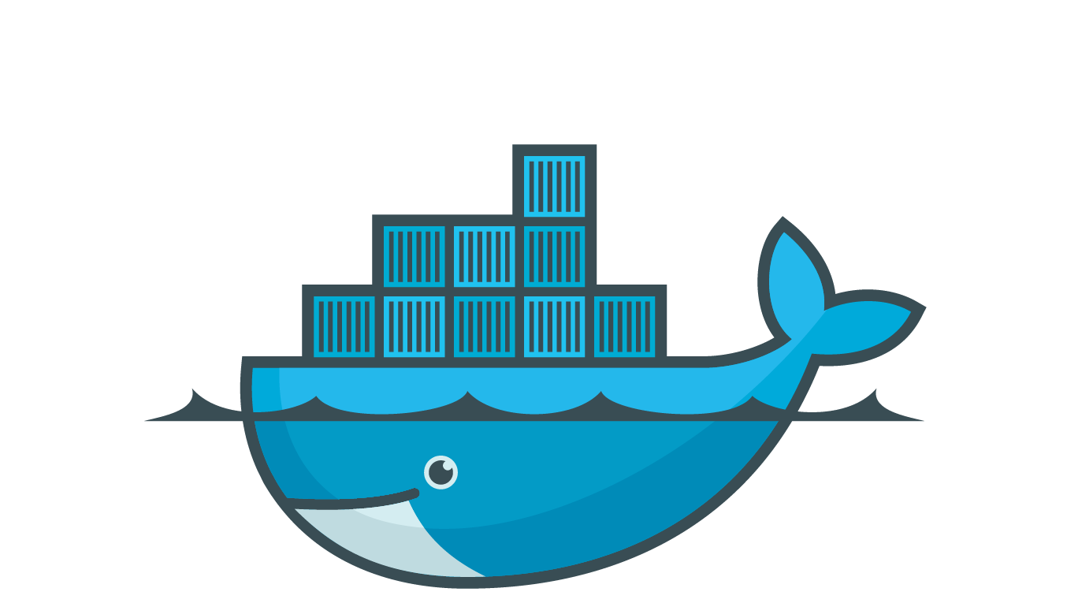
What is Docker
= ?
Notes:
The open source tool that simplifies managing Linux containers.
A container is a sandbox environment that runs a collection of processes. Containers are light-weight VMs that share the same kernel as the host OS.
The way to provide a uniformed wrapper around a software package and entire application environments: «Build, Ship and Run Any App, Anywhere» [www.docker.com]

Slide 7









Docker Cluster Layers
Cluster Manager
Host
Docker Service
Container
Application
Notes:
Cluster Manager: Health of the cluster management service – availability, configuration
Hosts: Health of each Host in the cluster – system metrics
Docker Service: Health of each Docker service on each Host – system metrics, availability, configuration
Container: Health of each container around the cluster – system metrics, availability, configuration
Application: Health of Application Running inside the container – specific metrics per app type

Slide 8
SiteScope Docker Monitoring Diagram
Docker Cluster
Cluster Manager Use Case
Node in Cluster
Node in Cluster
Node in Cluster
Node in Cluster
Node in Cluster
Node in Cluster
SiteScope Server
Docker Service
Docker Service
Docker Service
Docker Service
Docker Service
Docker Service
Containers
Containers
Containers
Automatic Discovery
Containers
Containers
Containers
Applications
Applications
Applications
Applications
Applications
Applications
Cluster Manager
Notes:
Cluster Manager: Health of the cluster management service – availability, configuration
Hosts: Health of each Host in the cluster – system metrics
Docker Service: Health of each Docker service on each Host – system metrics, availability, configuration
Container: Health of each container around the cluster – system metrics, availability, configuration
Application: Health of Application Running inside the container – specific metrics per app type
Automatic Docker Monitoring
What is Docker - The open source tool that simplifies managing Linux containers. A container is a sandbox environment that runs a collection of processes. Containers are light-weight VMs that share the same kernel as the host OS.
Sitescopw now in beta can moniort:
Cluster Manager
Node
Docker Service
Docker Container
Application Discovery

Slide 9
Automatic Docker Monitoring
Cluster Manager: Health of the cluster management service – availability, configuration
Hosts: Health of each Host in the cluster – system metrics
Docker Service: Health of each Docker service on each Host – system metrics, availability, configuration
Container: Health of each container around the cluster – system metrics, availability, configuration
Application: Health of Application Running inside the container – specific metrics per app type
Notes:
What is Docker - The open source tool that simplifies managing Linux containers. A container is a sandbox environment that runs a collection of processes. Containers are light-weight VMs that share the same kernel as the host OS.
Sitescopw now in beta can moniort:
Cluster Manager
Node
Docker Service
Docker Container
Application Discovery

Slide 10
Demo

Slide 11
Thank you
Michal Mishalov / michael.mishalov@hp.com
SiteScope System Architect

Slide 12
Docker Cluster Managers Health Support
 | New Relic | AppsDynamic | DataDog | Nagios | HPE SiteScope
Cluster Manager | ✗ | ✗ | ✗ | ✗ | ✓
Node | ✓ | ✓ | ✓ | ✓ | ✓
Docker Service | ✓ | ? | ✓ | ✓ | ✓
Docker Container | ✓ | ✓ | ✓ | ✓ | ✓
Application Discovery | ✗ | ✗ | ✗ | ✗ | ✓
Checkmarks shown are symbols and can be copied and pasted into any desired cell within the table

